Slide 1
The name disambiguation problem
- New ideas from two papers

Slide 2
Overview
A brief Introduction to Information Extraction
GRAPE
A two-stage clustering approach
Our ideas

Slide 3
Introduction to Information Extraction (IE)
The goal:
Extract structured information from unstructured machine-readable documents.
A simple example
Kaiqi is a graduate student of SJTU.
Person | Occupation | Organization
Kaiqi | graduate student | SJTU

Slide 4
Subtasks of IE
Name Entity Recognition
Relationship Extraction
Entity resolution & disambiguation
Shanghai Jiao Tong University
SJTU
Shanghai Jiaotong University
Shanghai Jiao Tong University

Slide 5


Name disambiguation problem
Problem definition
Disambiguate different entities with the same appearance (name).
Methods to solve this problem
Topic-based
Features-based
Leveraging external knowledge
…
Andrew Appel
Andrew M. Appel
Aon Corporation’s first Chief Operating Officer
Andrew W. Appel
Professor and Department Chair,
Department of Computer Science
Princeton University

Slide 6
GRAPE
GRAPE - A Graph-Based Framework for Disambiguating People Appearances in Web Search, ICDM’09
By Lili Jiang, Jianyong Wang, Ning An, Shengyuan Wang, Jian Zhan, Lian Li
GRAPE framework:
Preprocessing → Extraction → Clustering
Data Cleaning
Chunk Windows
Tag Graph Building
Lingpipe
Connectivity Strength

Slide 7
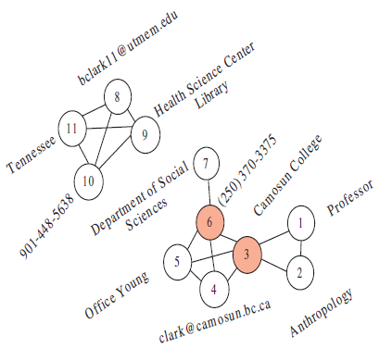
Tag Graph
Some concepts:
Tag type
Bridge tag
Micro cluster (Maximal clique)
Macro cluster
Basic assumption:
Names that appear in the same page refer to the same entity
Fig 1. An example for a tag graph

Slide 8
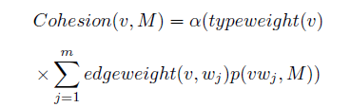

Cohesion & Connectivity Strength
Cohesion – weight for a tag
Why not TF-IDF?
Connectivity Strength

Slide 9
Summary for GRAPE
Contribution
Introducing a graph-based approach
A new measure – Cohesion
Drawbacks
The accuracy of the framework is largely based on tag extraction
The bottom-up clustering is expensive.

Slide 10
Cluster overlapping
Person Name Disambiguation on the Web by Two Stage Clustering, WePS-2
By Masaki Ikeda, Shingo Ono, Issei Sato, Minoru Yoshida, Hiroshi Nakagawa
Step 1:
Single-link clustering
Step 2:
Relocating documents in the clusters obtained from step 1.

Slide 11
An example for the 2nd stage clustering
---------------
---------------
---------------
---------------
---------------
copy
---------------
Kaiqi Zhao comes from Beijing….
…
Now, Kaiqi studies in Shanghai Jiaotong University…
Kaiqi from Beijing
Kaiqi from Guangdong
Compound key word
A multi-entities document

Slide 12
Summary for the two-stage clustering
Contribution
Provide a solution for cluster overlapping
Drawbacks
The second stage didn’t bring much accuracy improvement

Slide 13
What are we considering?
Give a cleaner context to feature extraction
Leverage a knowledge base

Slide 14
The End
Thank you!

